Slide 1

Exploratory Data Analysis
G2M insight for Cab investment firm
21 August 2023

Slide 2

Agenda
Executive Summary
Problem Statement
Approach
EDA
EDA Summary
Recommendations

Slide 3
Executive Summary
Considering the EDA performed on the dataset, it is advisable to consider investment in Yellow cab company

Slide 4
Problem Statement
XYZ company would like to invest in cab industry due to remarkable growth in the last few years and multiple key players in the market.
As per XYZ’s G2M strategy it would like to have better understanding of the market before investing
Different data sets have been provided which contains different aspects of potential company
Identify the right company to make investment in

Slide 5
Approach
Understand the relationship between the datasets , combine the datasets to make a master dataset
Check for null and duplicate values
Perform exploratory data analysis
Perform hypothesis testing

Slide 6
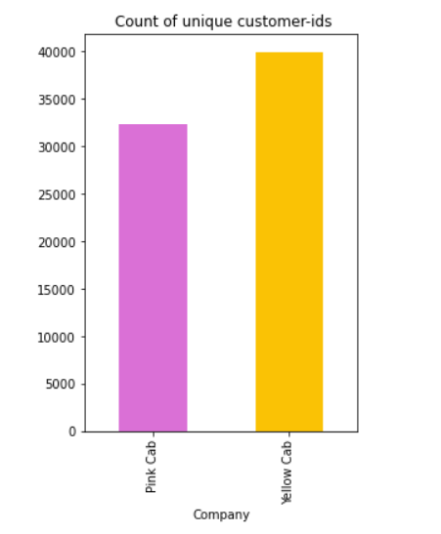
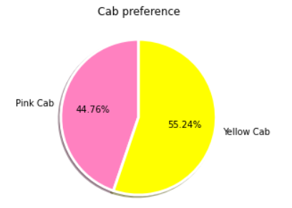
EDA
Unique customer cab preference in dataset
44.76% unique customers prefers Pink cab and 55.24% prefers Yellow Cab

Slide 7
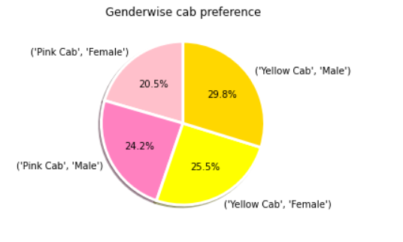
Gender-wise cab preference
20.5% of unique female customers and 24.2% male customers use pink cab, 29.8% male and 25.5 female customers use Yellow cabs.

Slide 8
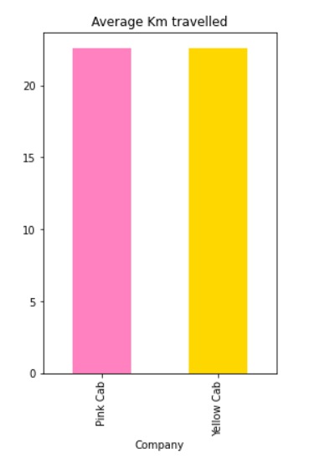
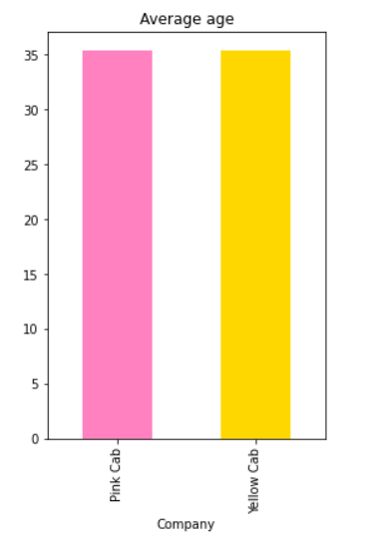
EDA
Average customer age at 35.32 and 35.34 for pink and yellow cab respectively
Average km travelled at 22.55 and 22.56 for pink and yellow cab respectively

Slide 9
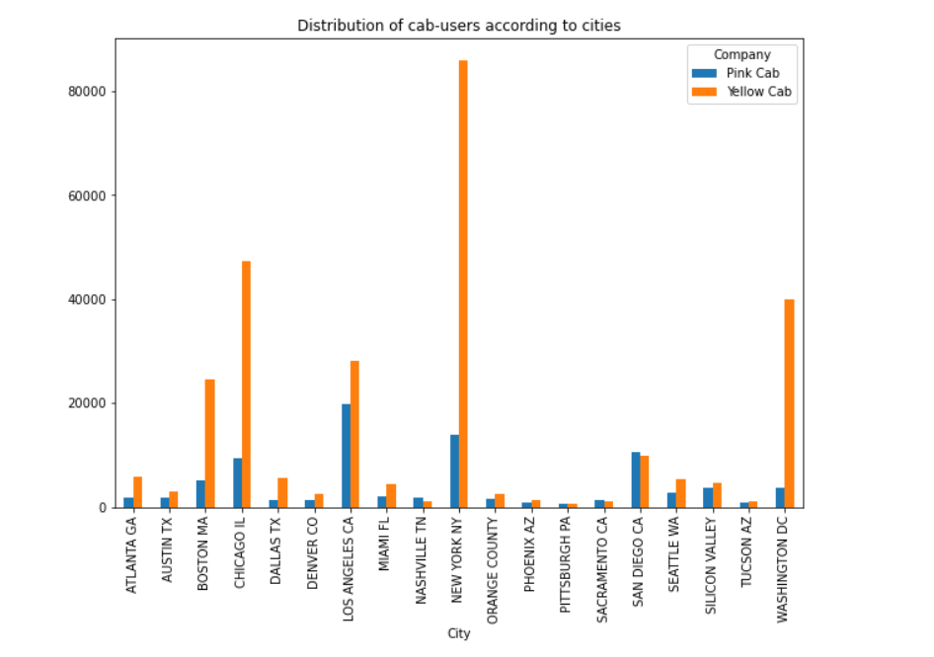
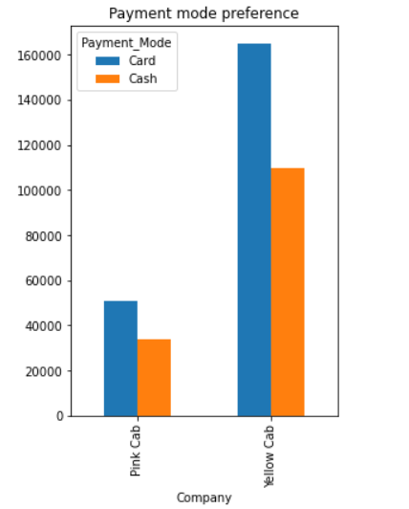
EDA
Payment mode
Distribution of users according to the cities

Slide 10
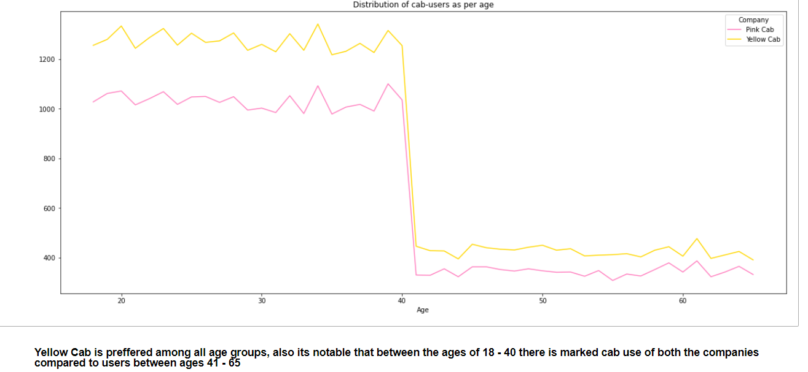
EDA
Distribution of cab users as per age

Slide 11
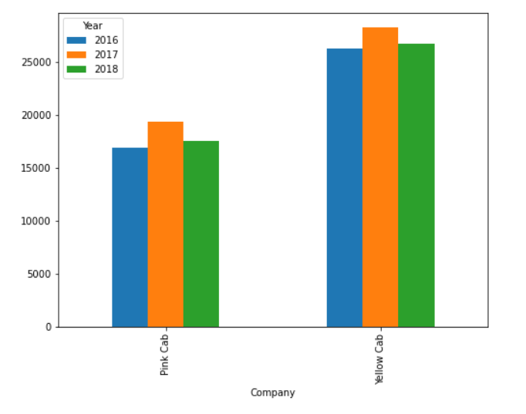
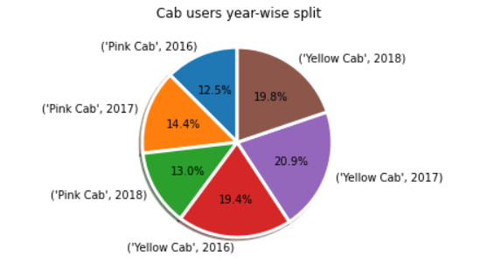
EDA
Year-wise cab users
Year-wise cab users percentage

Slide 12
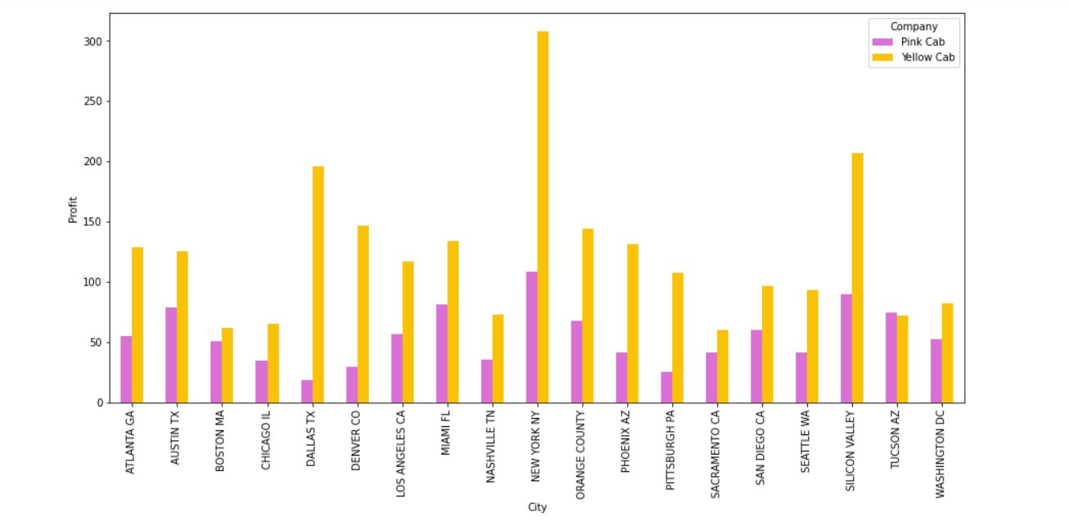
EDA
Average profits for both companies in all the cities

Slide 13
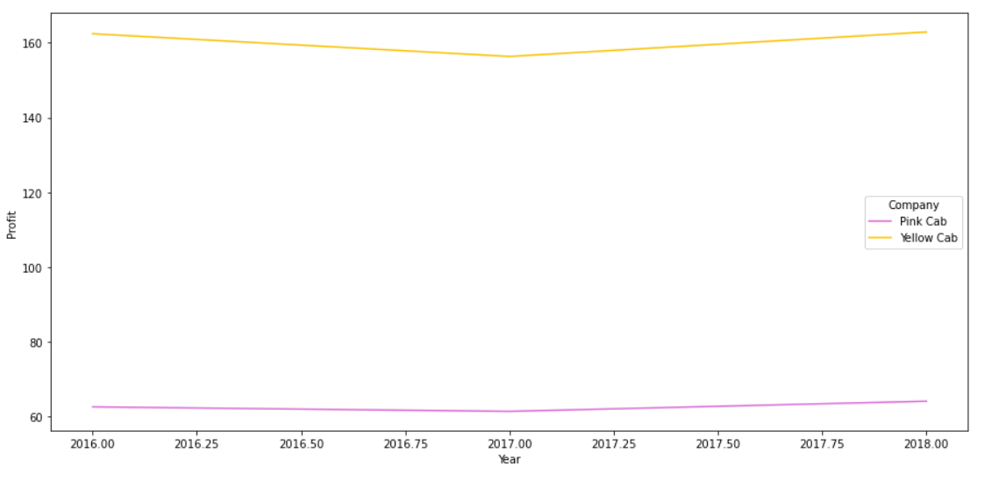
EDA
Plot of profit average in three years for both companies, profit took a dip for both companies in 2017

Slide 14
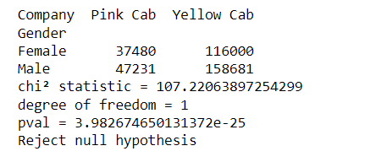
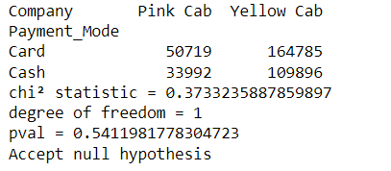
EDA
Hypothesis testing using chi2 test shows genders have cab company preference
Hypothesis testing using chi2 test shows there is no relationship between payment mode and cab company

Slide 15
EDA
Hypothesis testing using t-test shows Age groups have preference towards particular cab company

Slide 16
EDA Summary
Yellow cab performs well in all metrics
Profit earned and market share of Yellow cab is higher compared to Pink cab
Yellow cab has more customers in all the cities except for Nashville (TN), Pittsburgh (PA), Sacramento (CA) and San Diego (CA).
Despite customer numbers Yellow cab has higher profit than Pink cab in all the above four cities
The average distance travelled and average age of customers are almost same for both the cab companies

Slide 17
Recommendations
Yellow cab has the highest profit
It has the highest market share
Average profit margin is higher too for yellow cab
Looking at all the metrics it is advisable to consider investing in Yellow Cab

Slide 18
Thank You

